Slide 1

AE - 630
AHP Based Ranking of Evaluation Criteria for Design
Roll no : xxxxxxxxx

Slide 2
Criterion ID | Evaluation Criterion | Assigned Weight | Category | RFP Justification
C1 | Cruise Efficiency | 9 | Performance | 185 km outbound + return within time constraint (Sec 2.3)
C2 | Payload Fraction | 9 | Performance | 20 kg / 50 kg payload under fixed 160 kg GTOW
C3 | Ease of Transition | 9 | Packaging | Modular swap <10 min by 2 people (Sec 2.2.1)
C4 | Gust Tolerance | 7 | Safety/Performance | 15/8/3/5 m/s wind limits (Table 1)
C5 | CG Travel Limit | 7 | Safety | Add-on swaps up to 15% GTOW
C6 | Life Cycle Cost | 7 | Sustainable | Affordability explicitly required (Sec 1.5.2)
C7 | Compactness & Launch | 5 | Packaging | 6×6 m footprint + 4 UAV storage in 4×12×6 m hangar
C8 | Hover Efficiency | 5 | Performance | VTOL climb/descent + shipboard hover
C9 | Modularity for Storage | 3 | Safety | Rapid mission configuration (<10 min) nut secondary to footprint feasibility
C10 | Maintainability | 1 | Sustainable | All configuration assumed feasible at conceptual design level
C11 | Technological Maturity | 1 | Sustainable | Concept-level study; TRL discussion only

Slide 3
Prioritization Matrix
 | C1 | C2 | C3 | C4 | C5 | C6 | C7 | C8 | C9 | C10 | C11
C1 (Cruise Efficiency) | 1 | 1 | 1 | 3 | 3 | 3 | 5 | 5 | 7 | 9 | 9
C2 (Payload Fraction) | 1 | 1 | 1 | 3 | 3 | 3 | 5 | 5 | 7 | 9 | 9
C3 (Ease of Transition) | 1 | 1 | 1 | 3 | 3 | 3 | 5 | 5 | 7 | 9 | 9
C4 (Gust tolerance) | 1/3 | 1/3 | 1/3 | 1 | 1 | 1 | 3 | 3 | 5 | 7 | 7
C5 (CG Travel limit) | 1/3 | 1/3 | 1/3 | 1 | 1 | 1 | 3 | 3 | 5 | 7 | 7
C6 (Lifecycle Cost) | 1/3 | 1/3 | 1/3 | 1 | 1 | 1 | 3 | 3 | 5 | 7 | 7
C7 (Compactness & Launch) | 1/5 | 1/5 | 1/5 | 1/3 | 1/3 | 1/3 | 1 | 1 | 3 | 5 | 5
C8 (Hover Efficiency) | 1/5 | 1/5 | 1/5 | 1/3 | 1/3 | 1/3 | 1 | 1 | 3 | 5 | 5
C9 (Modularity for Storage) | 1/7 | 1/7 | 1/7 | 1/5 | 1/5 | 1/5 | 1/3 | 1/3 | 1 | 3 | 3
C10 (Maintainabilty) | 1/9 | 1/9 | 1/9 | 1/7 | 1/7 | 1/7 | 1/5 | 1/5 | 1/3 | 1 | 1
C11 (Technological Maturity) | 1/9 | 1/9 | 1/9 | 1/7 | 1/7 | 1/7 | 1/5 | 1/5 | 1/3 | 1 | 1
Column Sum | 4.311 | 4.311 | 4.311 | 13.476 | 13.476 | 13.476 | 26.733 | 26.733 | 43.666 | 69 | 69

Slide 4
Normalized Matrix
 | C1 | C2 | C3 | C4 | C5 | C6 | C7 | C8 | C9 | C10 | C11 | Priority Vector
C1 | 0.232 | 0.232 | 0.232 | 0.223 | 0.223 | 0.223 | 0.187 | 0.187 | 0.160 | 0.130 | 0.130 | 0.196
C2 | 0.232 | 0.232 | 0.232 | 0.223 | 0.223 | 0.223 | 0.187 | 0.187 | 0.160 | 0.130 | 0.130 | 0.196
C3 | 0.232 | 0.232 | 0.232 | 0.223 | 0.223 | 0.223 | 0.187 | 0.187 | 0.160 | 0.130 | 0.130 | 0.196
C4 | 0.077 | 0.077 | 0.077 | 0.074 | 0.074 | 0.074 | 0.112 | 0.112 | 0.115 | 0.101 | 0.101 | 0.090
C5 | 0.077 | 0.077 | 0.077 | 0.074 | 0.074 | 0.074 | 0.112 | 0.112 | 0.115 | 0.101 | 0.101 | 0.090
C6 | 0.077 | 0.077 | 0.077 | 0.074 | 0.074 | 0.074 | 0.112 | 0.112 | 0.115 | 0.101 | 0.101 | 0.090
C7 | 0.046 | 0.046 | 0.046 | 0.025 | 0.025 | 0.025 | 0.037 | 0.037 | 0.069 | 0.072 | 0.072 | 0.045
C8 | 0.046 | 0.046 | 0.046 | 0.025 | 0.025 | 0.025 | 0.037 | 0.037 | 0.069 | 0.072 | 0.072 | 0.045
C9 | 0.033 | 0.033 | 0.033 | 0.015 | 0.015 | 0.015 | 0.012 | 0.012 | 0.023 | 0.043 | 0.043 | 0.025
C10 | 0.026 | 0.026 | 0.026 | 0.011 | 0.011 | 0.011 | 0.007 | 0.007 | 0.008 | 0.014 | 0.014 | 0.015
C11 | 0.026 | 0.026 | 0.026 | 0.011 | 0.011 | 0.011 | 0.007 | 0.007 | 0.008 | 0.014 | 0.014 | 0.015

Slide 5
We now have n = 11 criteria, so we compute consistency for your 11×11 matrix.
Consistency Calculations (AHP)
Step 1: Data Used (from matrices)
Column Sums:
4.311, 4.311, 4.311, 13.476, 13.476, 13.476, 26.733, 26.733, 43.666, 69, 69
Step 2: Approximation of Largest Eigenvalue (λmax)
λmax ≈ (4.311 × 0.196) + (4.311 × 0.196) + (4.311 × 0.196) + (13.476 × 0.090) + (13.476 × 0.090) + (13.476 × 0.090) + (26.733 × 0.045) + (26.733 × 0.045) + (43.666 × 0.025) + (69 × 0.015) + (69 × 0.015)
Now calculating:
= 0.845 + 0.845 + 0.845 => λmax ≈ 11.74
Step 3: Consistency Index (CI) Step 4: Consistency Ratio (CR)
CI = (λmax − n) / (n − 1) Random Index (RI) for n = 11: R.I =1.51
CI = (11.74 − 11) / 10 CR = CI / RI CI = 0.74 / 10 CR = 0.074 / 1.51
CI = 0.074 CR = 0.049
Final Result
Consistency Ratio (CR) = 0.049
Since CR < 0.10, the matrix is consistent and acceptable

Slide 6
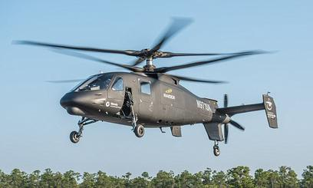
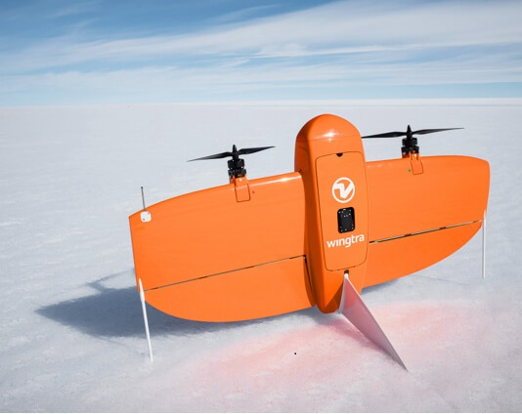
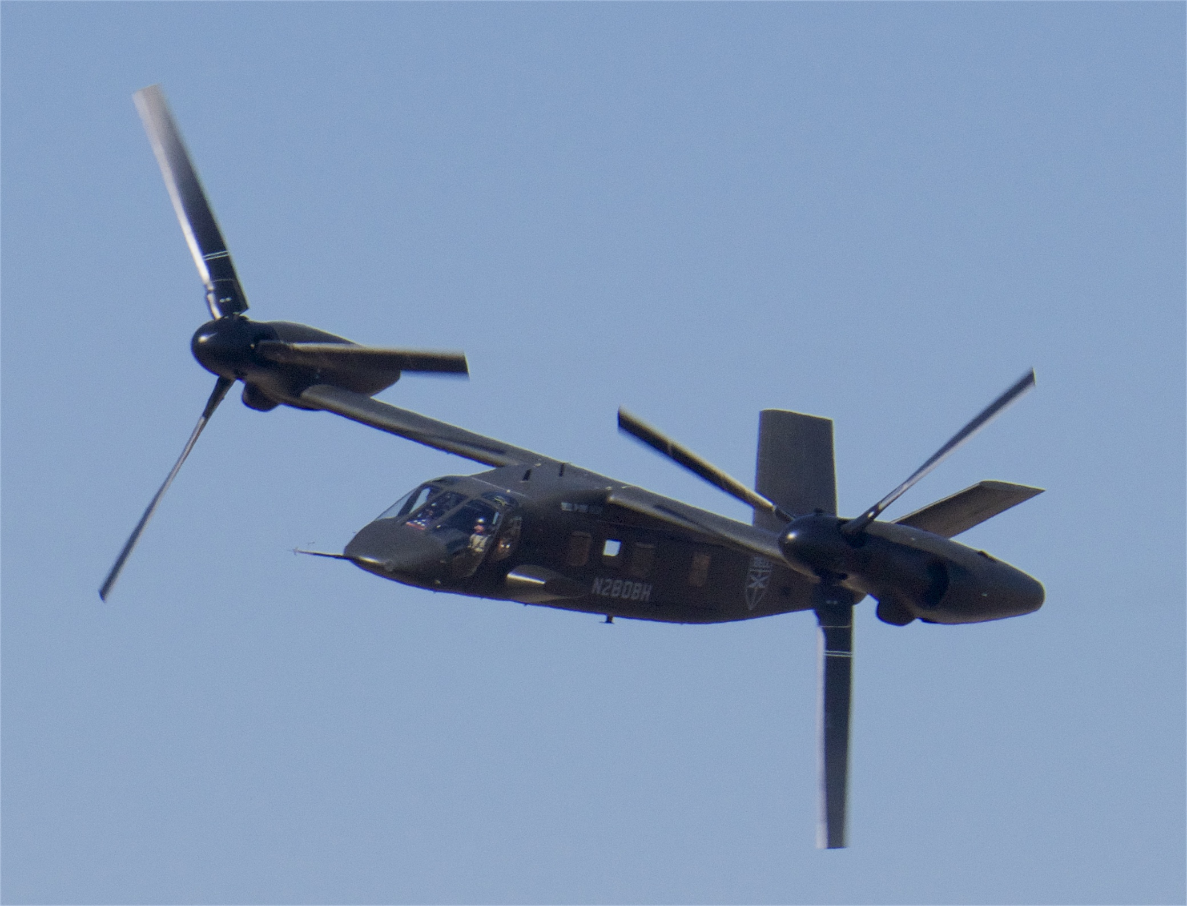
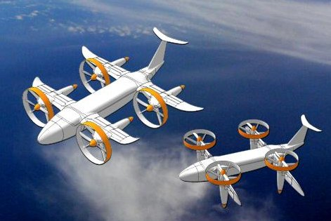
List of Configurations
First make a list of possible configurations :
Compound Helicopter (Co-axial + pusher)
Lift + Cruise VTOL (Quadplane Architecture / Hybrid VTOL)
Tilt Rotor
Tilt wing
Sikorsky S-97 Raider (Compound Helicopter)
Coaxial main rotors + pusher propeller
Improved cruise efficiency
High gust rejection capability
WingtraOne GEN II (Lift + Cruise VTOL)
Bell V-280 Valor (Tilt Rotor)
Tilt Wing
4 or more dedicated lift rotors
1 fixed wing for cruise efficiency
Separate propulsion for hover and forward flight
Tilting nacelles for transition
High-speed cruise performance
Proven military tiltrotor architecture
Entire wing tilts for transition
Large wing lifting surface
Moderate hover efficiency
Aerodynamic coupling during transition

Slide 7
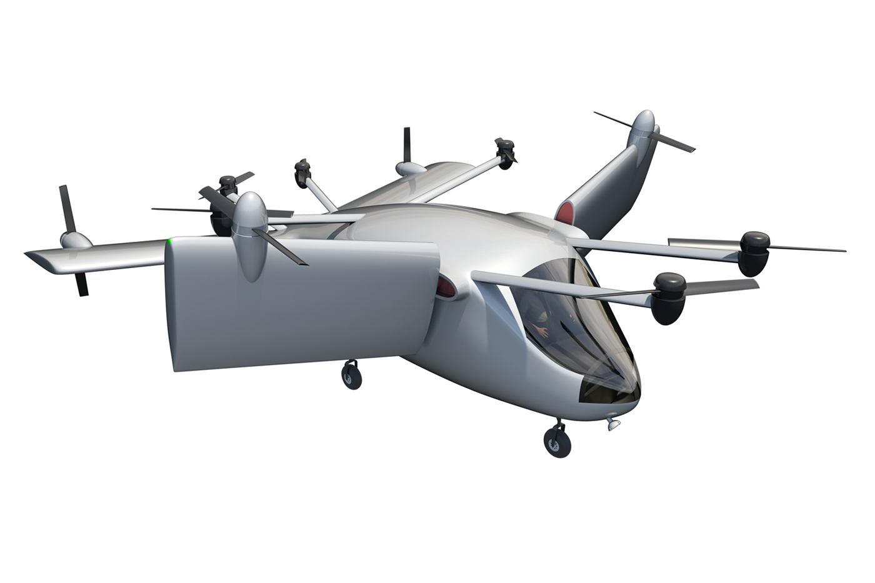
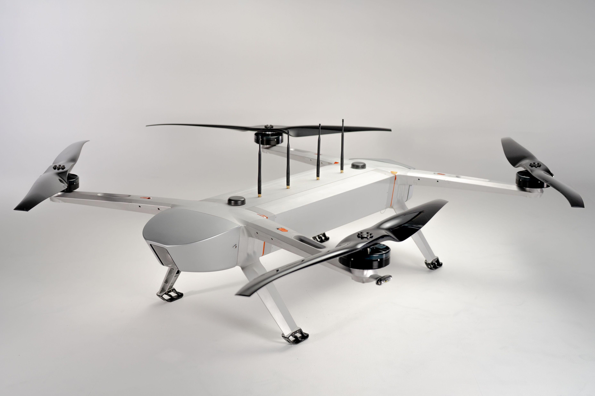
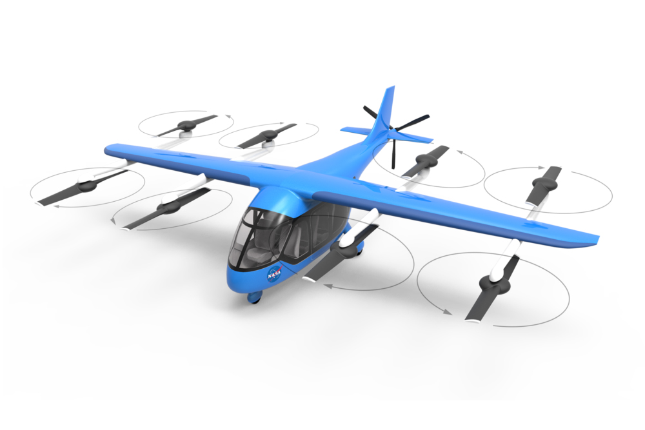
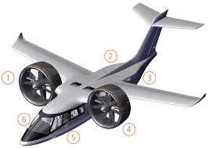
List of Configurations
Tandem Tilt-Rotor (UAV Scale)
Multirotor Heavy-Lift UAV (Octocopter Class)
Distributed Lift + Cruise VTOL (High-Rotor-Count Quadplane)
Ducted Fan VTOL (Lift + Cruise with Ducted Fans)

Slide 8
Gust Tolerance
Gust Tolerance | Compound Helicopter | Tilt Rotor | Lift + Cruise | Tilt Wing
Compound Helicopter | 1 | 7 | 5 | 5
Tilt Rotor | 1/7 | 1 | 1/5 | 1/3
Lift + Cruise | 1/5 | 5 | 1 | 3
Tilt Wing | 1/5 | 3 | 1/3 | 1
Column Sum | 1.543 | 16.000 | 6.533 | 9.333
Configuration | Compound Helicopter | Tilt Rotor | Lift + Cruise | Tilt Wing | Priority Vector
Compound Helicopter | 0.648 | 0.438 | 0.765 | 0.536 | 0.60
Tilt Rotor | 0.093 | 0.063 | 0.031 | 0.036 | 0.06
Lift + Cruise | 0.130 | 0.313 | 0.153 | 0.321 | 0.23
Tilt Wing | 0.130 | 0.188 | 0.051 | 0.107 | 0.12
Sum | 1.00 | 1.00 | 1.00 | 1.00 | 1.00
Consistency Ratio (CR) ≈ 0.04, Compound helicopter demonstrates the highest gust tolerance due to large rotor disk area, coaxial configuration, and inherent aerodynamic damping, making it most suitable for shipboard VTOL operations.
Hover Efficiency
Hover Efficiency | Compound Helicopter | Tilt Rotor | Lift + Cruise | Tilt Wing
Compound Helicopter | 1 | 7 | 5 | 5
Tilt Rotor | 1/7 | 1 | 1/5 | 1/3
Lift + Cruise | 1/5 | 5 | 1 | 3
Tilt Wing | 1/5 | 3 | 1/3 | 1
Column Sum | 1.543 | 16.000 | 6.533 | 9.333
Configuration | Compound Helicopter | Tilt Rotor | Lift + Cruise | Tilt Wing | Priority Vector
Compound Helicopter | 0.648 | 0.438 | 0.765 | 0.536 | 0.60
Tilt Rotor | 0.093 | 0.063 | 0.031 | 0.036 | 0.06
Lift + Cruise | 0.130 | 0.313 | 0.153 | 0.321 | 0.23
Tilt Wing | 0.130 | 0.188 | 0.051 | 0.107 | 0.12
Sum | 1.00 | 1.00 | 1.00 | 1.00 | 1.00
Consistency Ratio (CR) ≈ 0.056, Compound helicopter exhibits the highest hover efficiency due to low disk loading and continuous rotor operation, making it most suitable for power-intensive shipboard VTOL phases.

Slide 9
Cruise Efficiency
Cruise Efficiency | Compound Helicopter | Tilt Rotor | Lift + Cruise | Tilt Wing
Compound Helicopter | 1 | 1/3 | 1/5 | 1/3
Tilt Rotor | 3 | 1 | 1/3 | 1
Lift + Cruise | 5 | 3 | 1 | 3
Tilt Wing | 3 | 1 | 1/3 | 1
Column Sum | 12.000 | 5.333 | 1.867 | 5.333
Configuration | Compound Helicopter | Tilt Rotor | Lift + Cruise | Tilt Wing | Priority Vector
Compound Helicopter | 0.083 | 0.063 | 0.107 | 0.063 | 0.08
Tilt Rotor | 0.250 | 0.188 | 0.179 | 0.188 | 0.20
Lift + Cruise | 0.417 | 0.563 | 0.536 | 0.563 | 0.52
Tilt Wing | 0.250 | 0.188 | 0.179 | 0.188 | 0.20
Sum | 1.00 | 1.00 | 1.00 | 1.00 | 1.00
Consistency Ratio (CR) ≈ 0.05, Lift + Cruise VTOL achieves the highest cruise efficiency due to fixed-wing lift dominance and decoupled hover propulsion, making it most suitable for long-range outbound and return missions.
Payload Fraction
Payload Fraction | Compound Helicopter | Tilt Rotor | Lift + Cruise | Tilt Wing
Compound Helicopter | 1 | 1 | 3 | 3
Tilt Rotor | 1 | 1 | 3 | 3
Lift + Cruise | 1/3 | 1/3 | 1 | 1
Tilt Wing | 1/3 | 1/3 | 1 | 1
Column Sum | 2.667 | 2.667 | 8.000 | 8.000
Configuration | Compound Helicopter | Tilt Rotor | Lift + Cruise | Tilt Wing | Priority Vector
Compound Helicopter | 0.375 | 0.375 | 0.375 | 0.375 | 0.38
Tilt Rotor | 0.375 | 0.375 | 0.375 | 0.375 | 0.38
Lift + Cruise | 0.125 | 0.125 | 0.125 | 0.125 | 0.13
Tilt Wing | 0.125 | 0.125 | 0.125 | 0.125 | 0.13
Sum | 1.00 | 1.00 | 1.00 | 1.00 | 1.00
Consistency Ratio (CR) ≈ 0.05, Compound helicopter and tilt-rotor configurations provide the highest payload fraction due to efficient rotor-based lift and reduced structural penalties under fixed GTOW constraints.

Slide 10
CG Travel Limit
CG Travel Limit | Compound Helicopter | Tilt Rotor | Lift + Cruise | Tilt Wing
Compound Helicopter | 1 | 3 | 5 | 5
Tilt Rotor | 1/3 | 1 | 3 | 3
Lift + Cruise | 1/5 | 1/3 | 1 | 1
Tilt Wing | 1/5 | 1/3 | 1 | 1
Column Sum | 1.733 | 4.667 | 10.000 | 10.000
Configuration | Compound Helicopter | Tilt Rotor | Lift + Cruise | Tilt Wing | Priority Vector
Compound Helicopter | 0.577 | 0.643 | 0.500 | 0.500 | 0.56
Tilt Rotor | 0.192 | 0.214 | 0.300 | 0.300 | 0.25
Lift + Cruise | 0.115 | 0.071 | 0.100 | 0.100 | 0.10
Tilt Wing | 0.115 | 0.071 | 0.100 | 0.100 | 0.10
Sum | 1.00 | 1.00 | 1.00 | 1.00 | 1.00
Consistency Ratio (CR) ≈ 0.03, Compound helicopter accommodates larger CG shifts due to centrally located lift rotor and symmetric configuration, making it most robust under modular payload swaps.
Compactness & Launch
Compactness & Launch | Compound Helicopter | Tilt Rotor | Lift + Cruise | Tilt Wing
Compound Helicopter | 1 | 3 | 1/3 | 1
Tilt Rotor | 1/3 | 1 | 1/5 | 1/3
Lift + Cruise | 3 | 5 | 1 | 3
Tilt Wing | 1 | 3 | 1/3 | 1
Column Sum | 5.333 | 12.000 | 1.867 | 5.333
Configuration | Compound Helicopter | Tilt Rotor | Lift + Cruise | Tilt Wing | Priority Vector
Compound Helicopter | 0.188 | 0.250 | 0.179 | 0.188 | 0.20
Tilt Rotor | 0.063 | 0.083 | 0.107 | 0.063 | 0.08
Lift + Cruise | 0.563 | 0.417 | 0.536 | 0.563 | 0.52
Tilt Wing | 0.188 | 0.250 | 0.179 | 0.188 | 0.20
Sum | 1.00 | 1.00 | 1.00 | 1.00 | 1.00
Consistency Ratio (CR) ≈ 0.05, Lift + Cruise VTOL achieves the highest compactness due to foldable lift rotors and fixed-wing cruise layout, enabling efficient deck operations and hangar storage.

Slide 11
Modularity for Storage
Modularity for Storage | Compound Helicopter | Tilt Rotor | Lift + Cruise | Tilt Wing
Compound Helicopter | 1 | 3 | 1/3 | 1
Tilt Rotor | 1/3 | 1 | 1/5 | 1/3
Lift + Cruise | 3 | 5 | 1 | 3
Tilt Wing | 1 | 3 | 1/3 | 1
Column Sum | 5.333 | 12.000 | 1.867 | 5.333
Configuration | Compound Helicopter | Tilt Rotor | Lift + Cruise | Tilt Wing | Priority Vector
Compound Helicopter | 0.188 | 0.250 | 0.179 | 0.188 | 0.20
Tilt Rotor | 0.063 | 0.083 | 0.107 | 0.063 | 0.08
Lift + Cruise | 0.563 | 0.417 | 0.536 | 0.563 | 0.52
Tilt Wing | 0.188 | 0.250 | 0.179 | 0.188 | 0.20
Sum | 1.00 | 1.00 | 1.00 | 1.00 | 1.00
Consistency Ratio (CR) ≈ 0.05, Lift + Cruise VTOL offers the highest modularity due to discrete lift units and clear payload interfaces, enabling rapid reconfiguration and efficient shipboard storage.
Lifecycle Cost
Life Cycle Cost | Compound Helicopter | Tilt Rotor | Lift + Cruise | Tilt Wing
Compound Helicopter | 1 | 3 | 1/3 | 3
Tilt Rotor | 1/3 | 1 | 1/5 | 1
Lift + Cruise | 3 | 5 | 1 | 5
Tilt Wing | 1/3 | 1 | 1/5 | 1
Column Sum | 4.666 | 10 | 1.733 | 10
Configuration | Compound Helicopter | Tilt Rotor | Lift + Cruise | Tilt Wing | Priority Vector
Compound Helicopter | 0.214 | 0.300 | 0.192 | 0.300 | 0.27
Tilt Rotor | 0.071 | 0.100 | 0.115 | 0.100 | 0.10
Lift + Cruise | 0.643 | 0.500 | 0.577 | 0.500 | 0.54
Tilt Wing | 0.071 | 0.100 | 0.115 | 0.100 | 0.09
Sum | 1.00 | 1.00 | 1.00 | 1.00 | 1.00
Consistency Ratio (CR) ≈ 0.05, Lift + Cruise VTOL offers the highest life cycle cost .

Slide 12
Maintainability
Maintainability | Compound Helicopter | Tilt Rotor | Lift + Cruise | Tilt Wing
Compound Helicopter | 1 | 3 | 1 | 3
Tilt Rotor | 1/3 | 1 | 1/3 | 1
Lift + Cruise | 1 | 3 | 1 | 3
Tilt Wing | 1/3 | 1 | 1/3 | 1
Column Sum | 2.667 | 8.000 | 2.667 | 8.000
Configuration | Compound Helicopter | Tilt Rotor | Lift + Cruise | Tilt Wing | Priority Vector
Compound Helicopter | 0.375 | 0.375 | 0.375 | 0.375 | 0.38
Tilt Rotor | 0.125 | 0.125 | 0.125 | 0.125 | 0.13
Lift + Cruise | 0.375 | 0.375 | 0.375 | 0.375 | 0.38
Tilt Wing | 0.125 | 0.125 | 0.125 | 0.125 | 0.13
Sum | 1.00 | 1.00 | 1.00 | 1.00 | 1.00
Ease of Transition
Ease of Transition | Compound | Tilt Rotor | Lift + Cruise | Tilt Wing
Compound | 1 | 3 | 1/3 | 5
Tilt Rotor | 1/3 | 1 | 1/5 | 3
Lift + Cruise | 3 | 5 | 1 | 7
Tilt Wing | 1/5 | 1/3 | 1/7 | 1
Column Sum | 4.533 | 9.333 | 1.676 | 16
Configuration | Compound Helicopter | Tilt Rotor | Lift + Cruise | Tilt Wing | Priority Vector
Compound Helicopter | 0.221 | 0.321 | 0.199 | 0.313 | 0.26
Tilt Rotor | 0.074 | 0.107 | 0.119 | 0.188 | 0.13
Lift + Cruise | 0.662 | 0.536 | 0.597 | 0.438 | 0.55
Tilt Wing | 0.044 | 0.036 | 0.085 | 0.063 | 0.06
Sum | 1.00 | 1.00 | 1.00 | 1.00 | 1.00

Slide 13
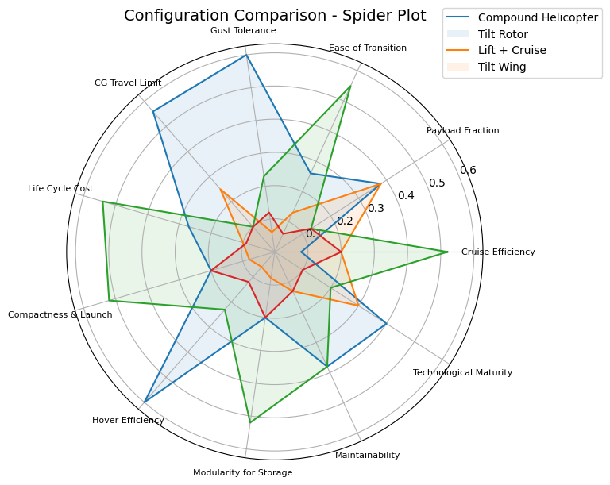
Final Weight Summary
Final Score | Weights | Compound Helicopter | Tilt Rotor | Lift + Cruise | Tilt Wing
Cruise Efficiency | 0.196 | 0.08 | 0.20 | 0.52 | 0.20
Payload Fraction | 0.196 | 0.38 | 0.38 | 0.13 | 0.13
Ease of Transition | 0.196 | 0.26 | 0.13 | 0.55 | 0.06
Gust Tolerance | 0.090 | 0.60 | 0.06 | 0.23 | 0.12
CG Travel Limit | 0.090 | 0.56 | 0.25 | 0.10 | 0.10
Life Cycle Cost | 0.090 | 0.27 | 0.10 | 0.54 | 0.09
Compactness & Launch | 0.045 | 0.20 | 0.08 | 0.52 | 0.20
Hover Efficiency | 0.045 | 0.60 | 0.06 | 0.23 | 0.12
Modularity for Storage | 0.025 | 0.20 | 0.08 | 0.52 | 0.20
Maintainability | 0.015 | 0.38 | 0.13 | 0.38 | 0.13
Technological Maturity | 0.015 | 0.40 | 0.30 | 0.20 | 0.10
Final Scores | 1.00 | 0.35 | 0.19 | 0.43 | 0.13

Slide 14
Final Ranking (Based on AHP Summary Scores)
Lift + Cruise VTOL / Hybrid VTOL
Compound Helicopter
Tilt Rotor
Tilt Wing
Lift + cruise VTOL ranks highest because of excellent cruise efficiency and compact storage,
but lower gust tolerance than rotor-based concepts.
Compound helicopter ranks second due to superior gust tolerance, efficient hover,
and robustness to CG shifts, making it best suited for shipboard VTOL operations, but lower compactness.
Tilt rotor offers high cruise performance, however large footprint and mechanical complexity
reduce suitability for constrained ship decks.
Tilt wing suffers from gust sensitivity and complex transition aerodynamics, limiting its effectiveness in disturbed ship airwake conditions.
Overall ranking strongly aligns with RFP priorities, where gust tolerance, hover performance, and deck operability dominate configuration selection.

